Slide 1
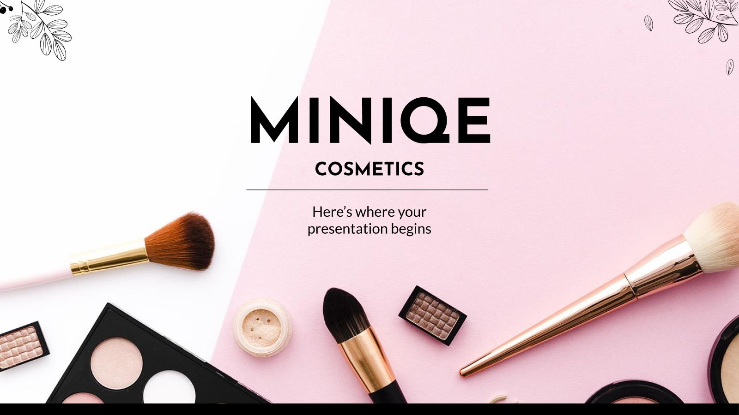
Cosmetics Ecommerce website
Lebanese University
Chaza Dally 112906
Ali Assi 112892
Jana Al Mawla 112893

Slide 2
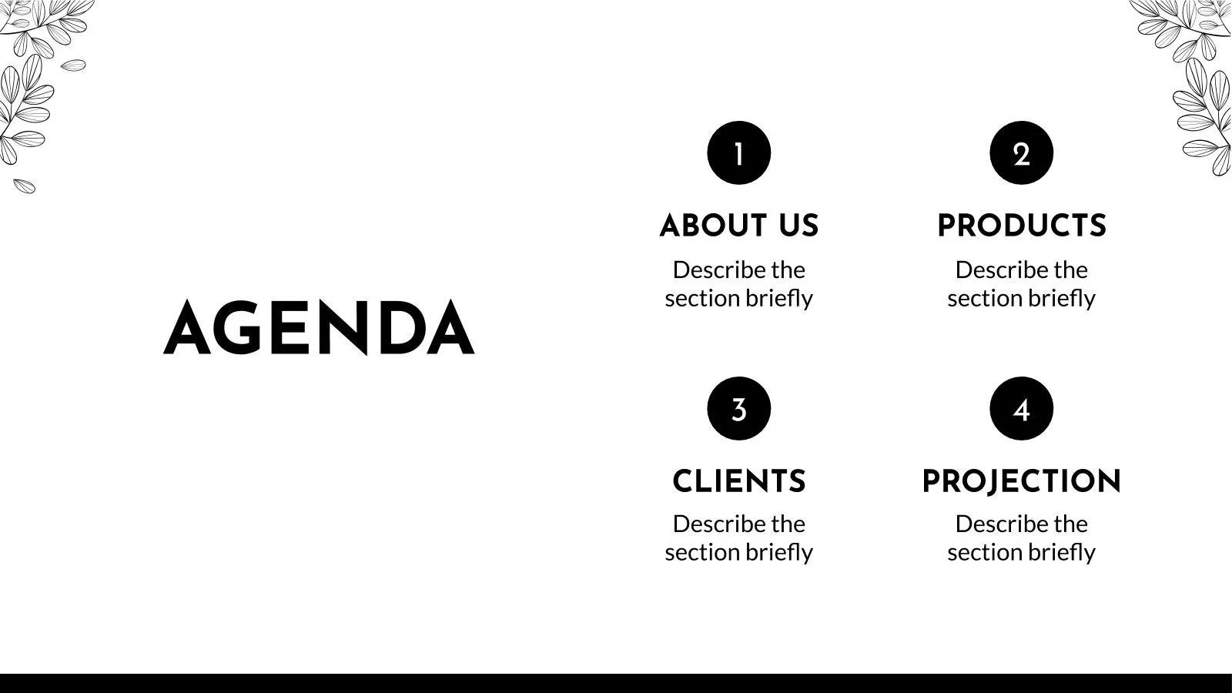
Introduction
Describe the goal of project
Use case and class diagram
Contents
Future features
Pages
Describe each page in the website j

Slide 3
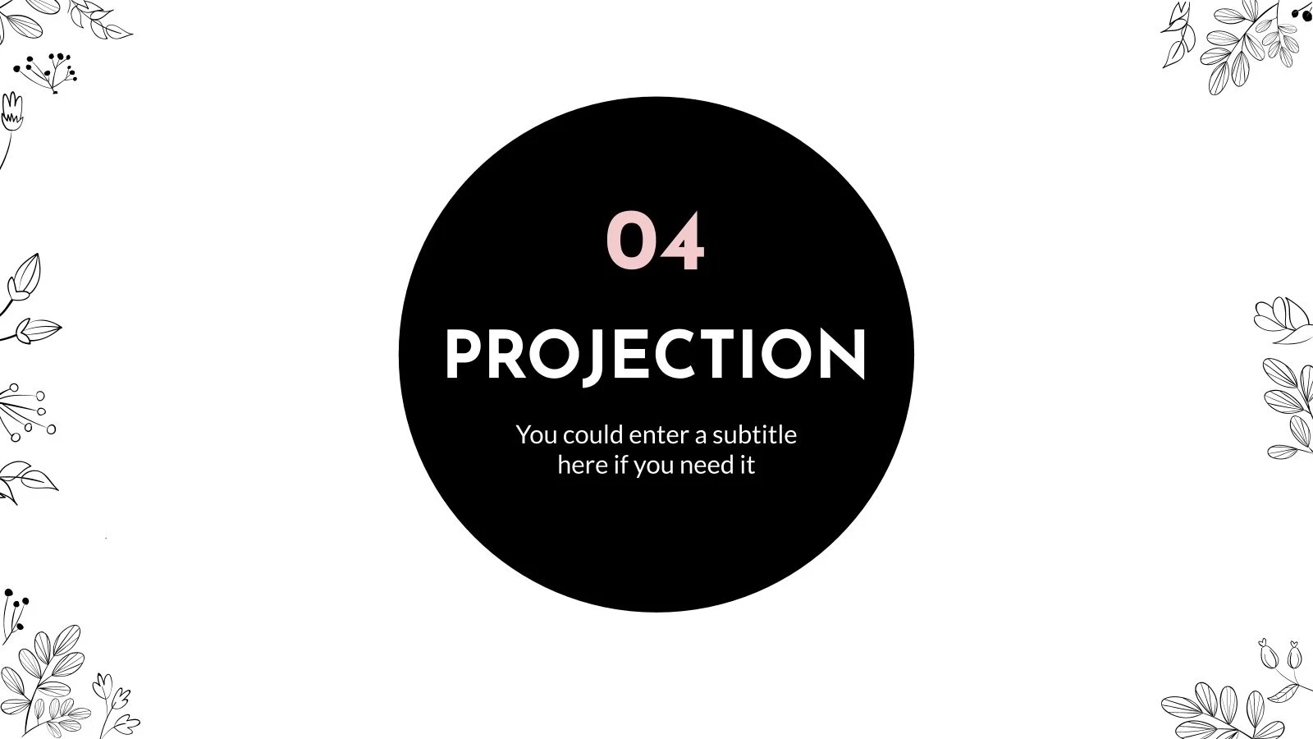
1
Introduction

Slide 4
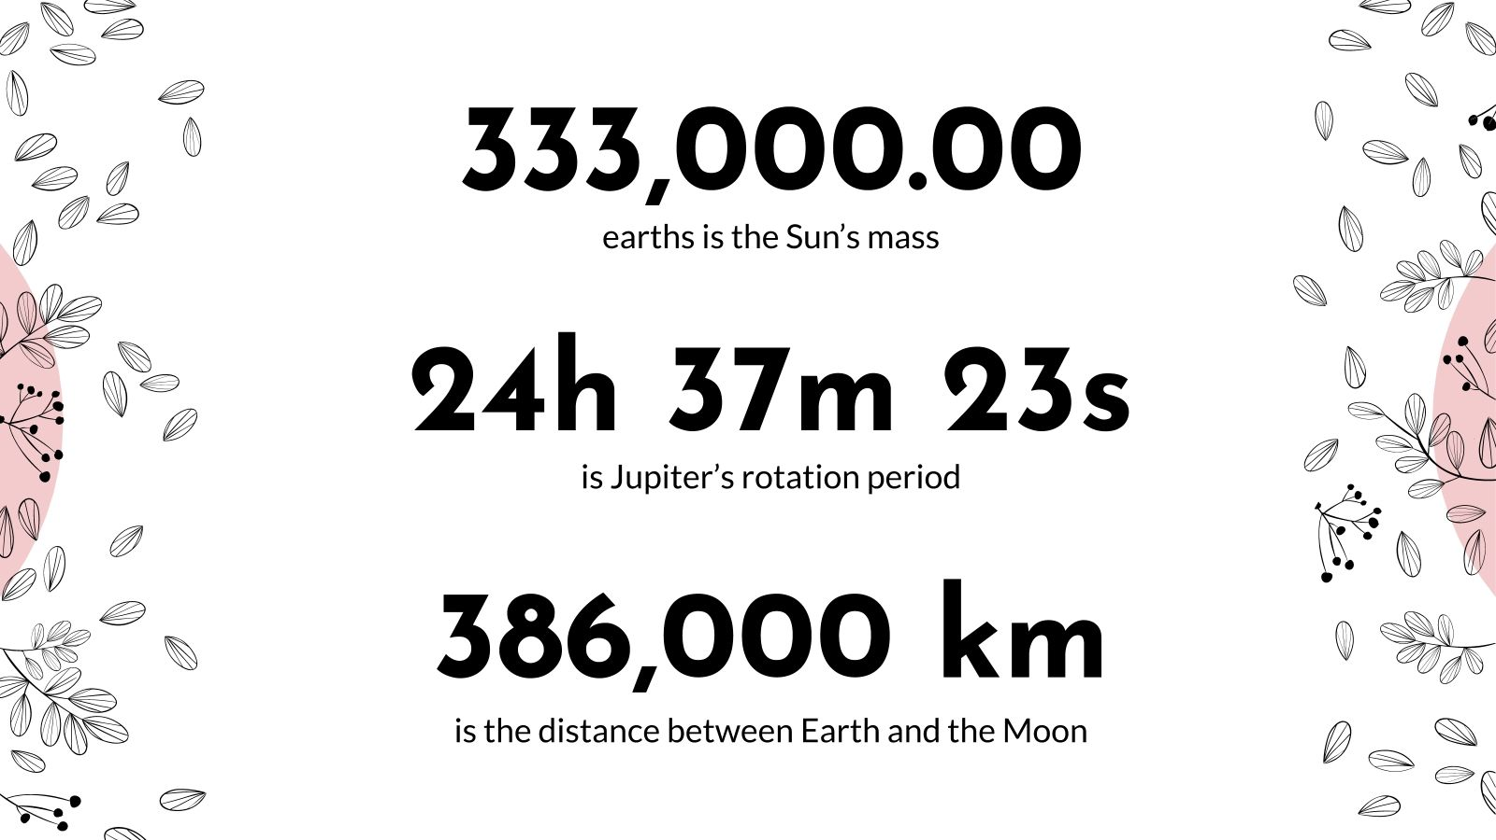
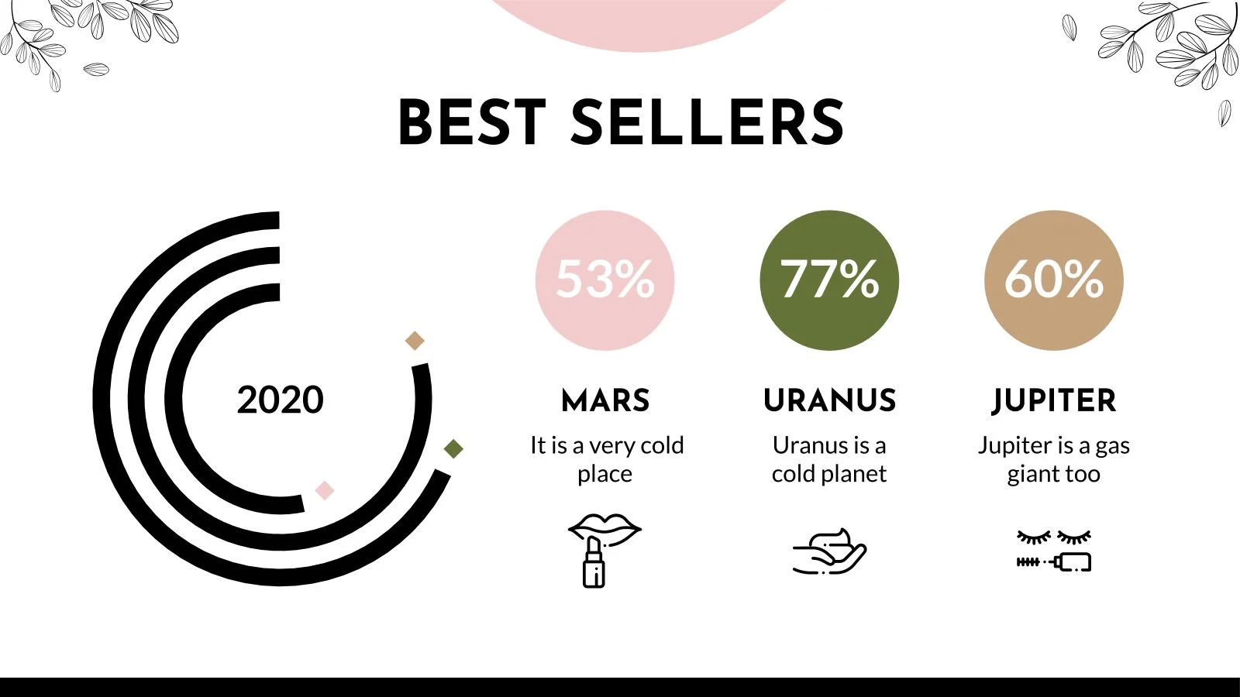
This project creates a user-friendly e-commerce platform for the cosmetics industry, featuring product browsing, secure transactions, and efficient management. The goal is to enhance customer experience, boost purchase rates, and ensure fast, smooth operations for both users and administrators.
2000 2020 2010

Slide 5
2
Use case and class diagram

Slide 6
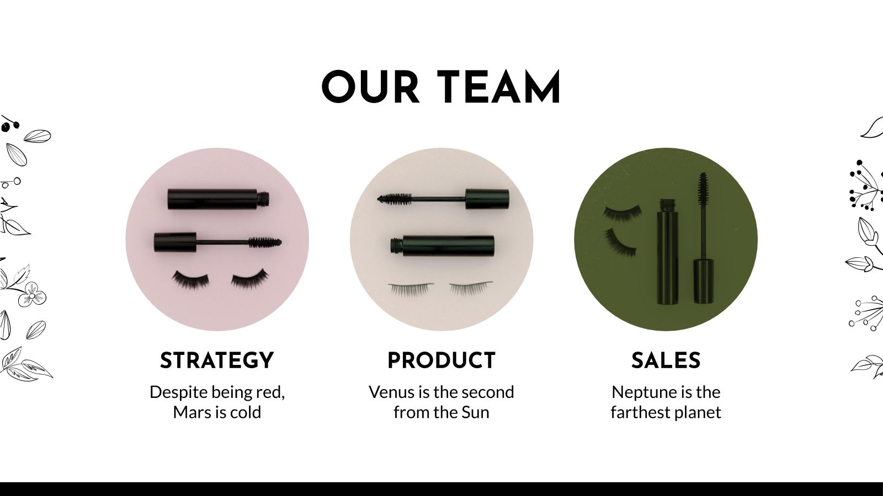
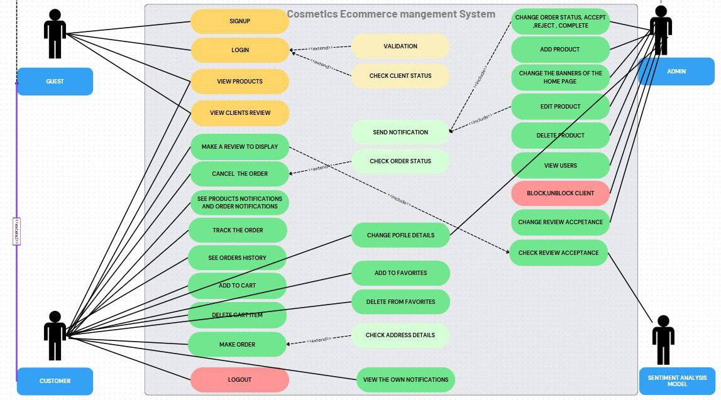

Slide 7

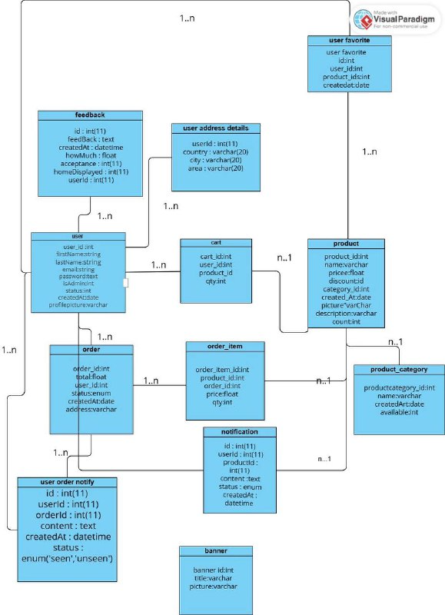


Slide 8
3
Pages

Slide 9
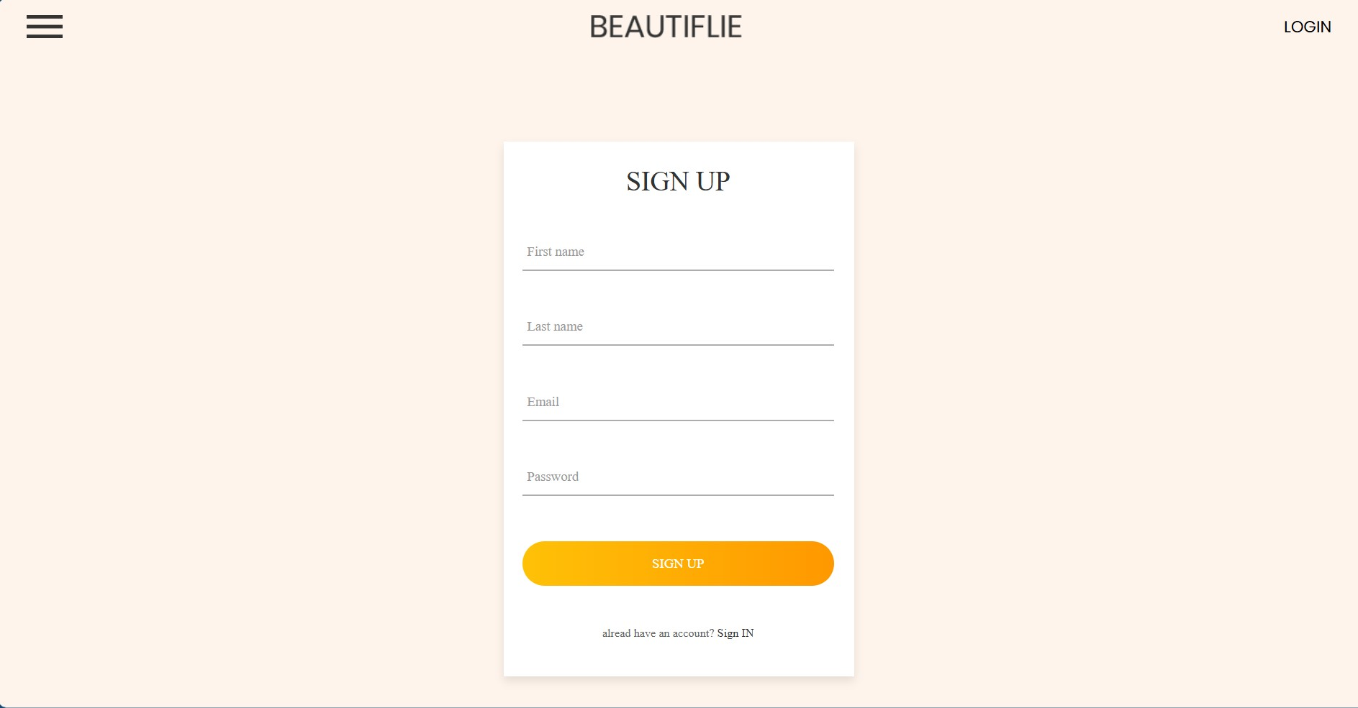


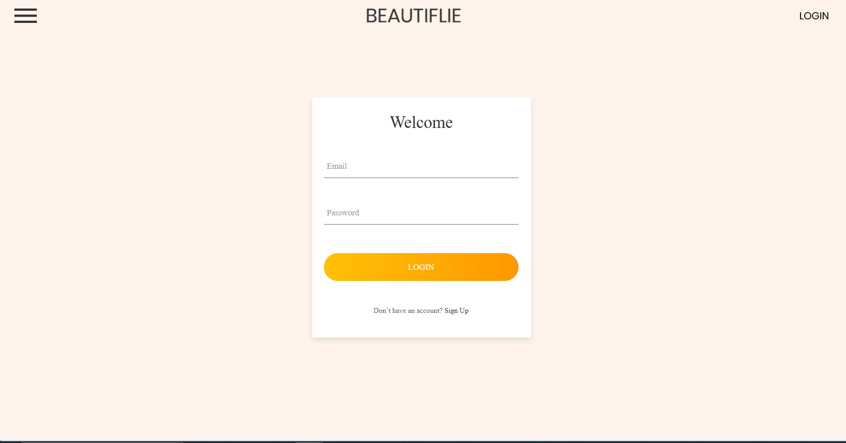

Slide 10
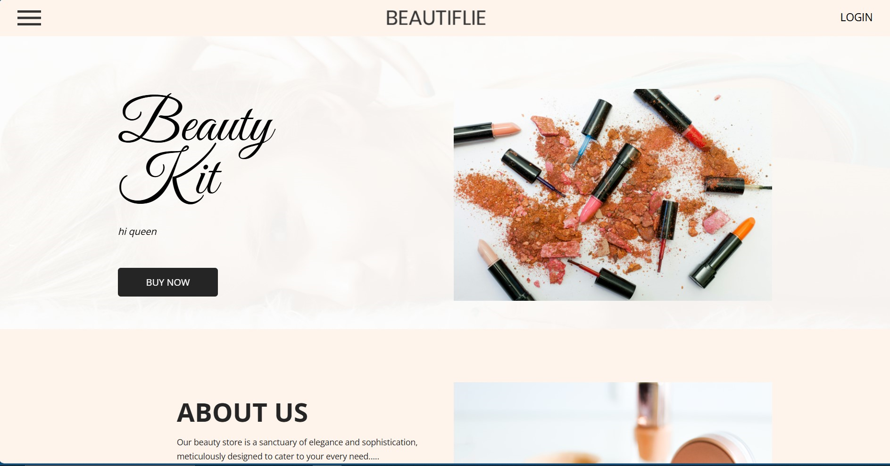
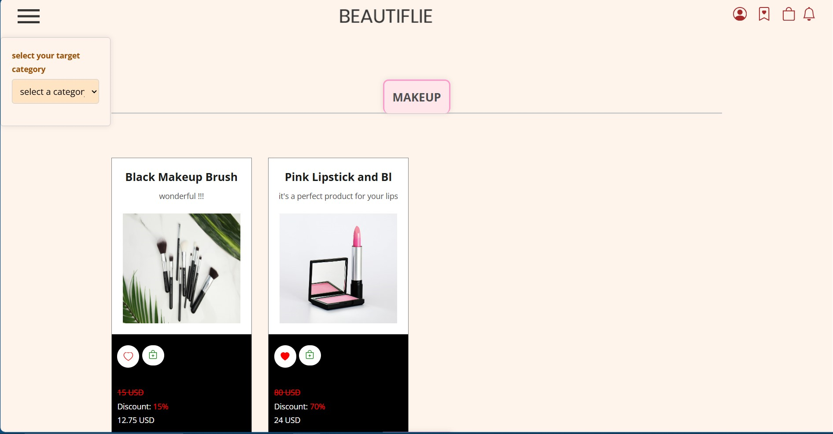

Slide 11
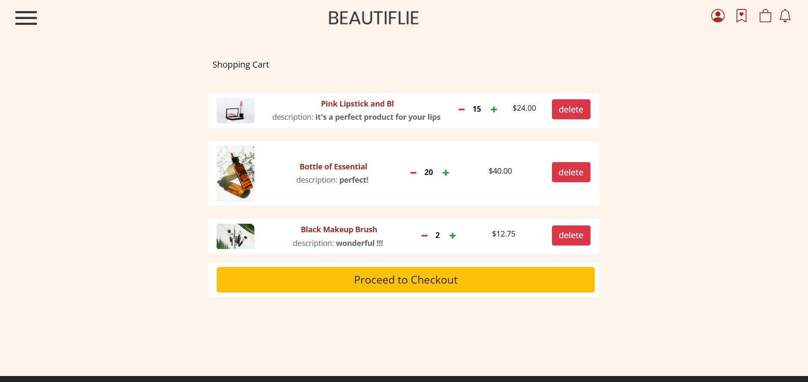
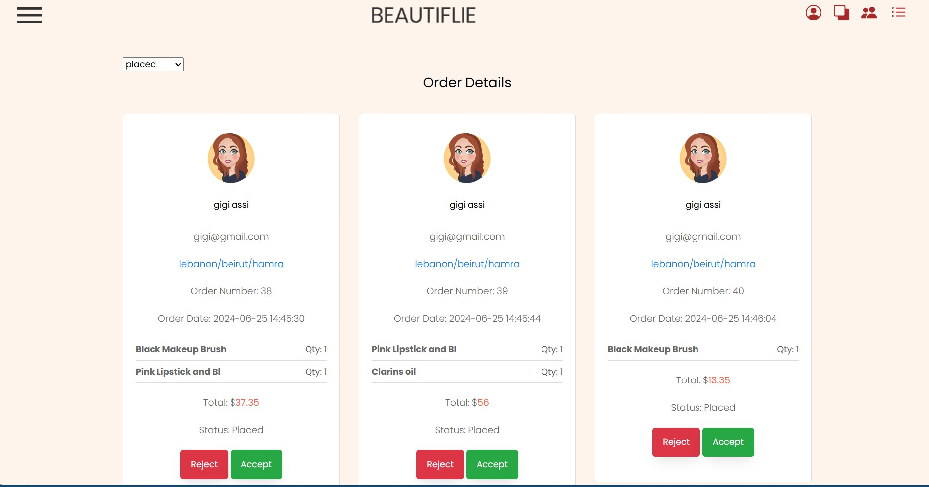

Slide 12
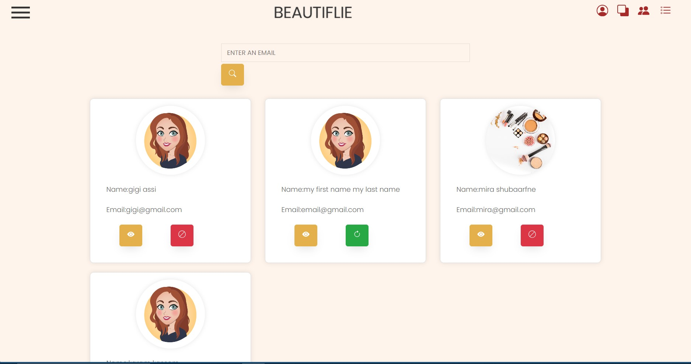
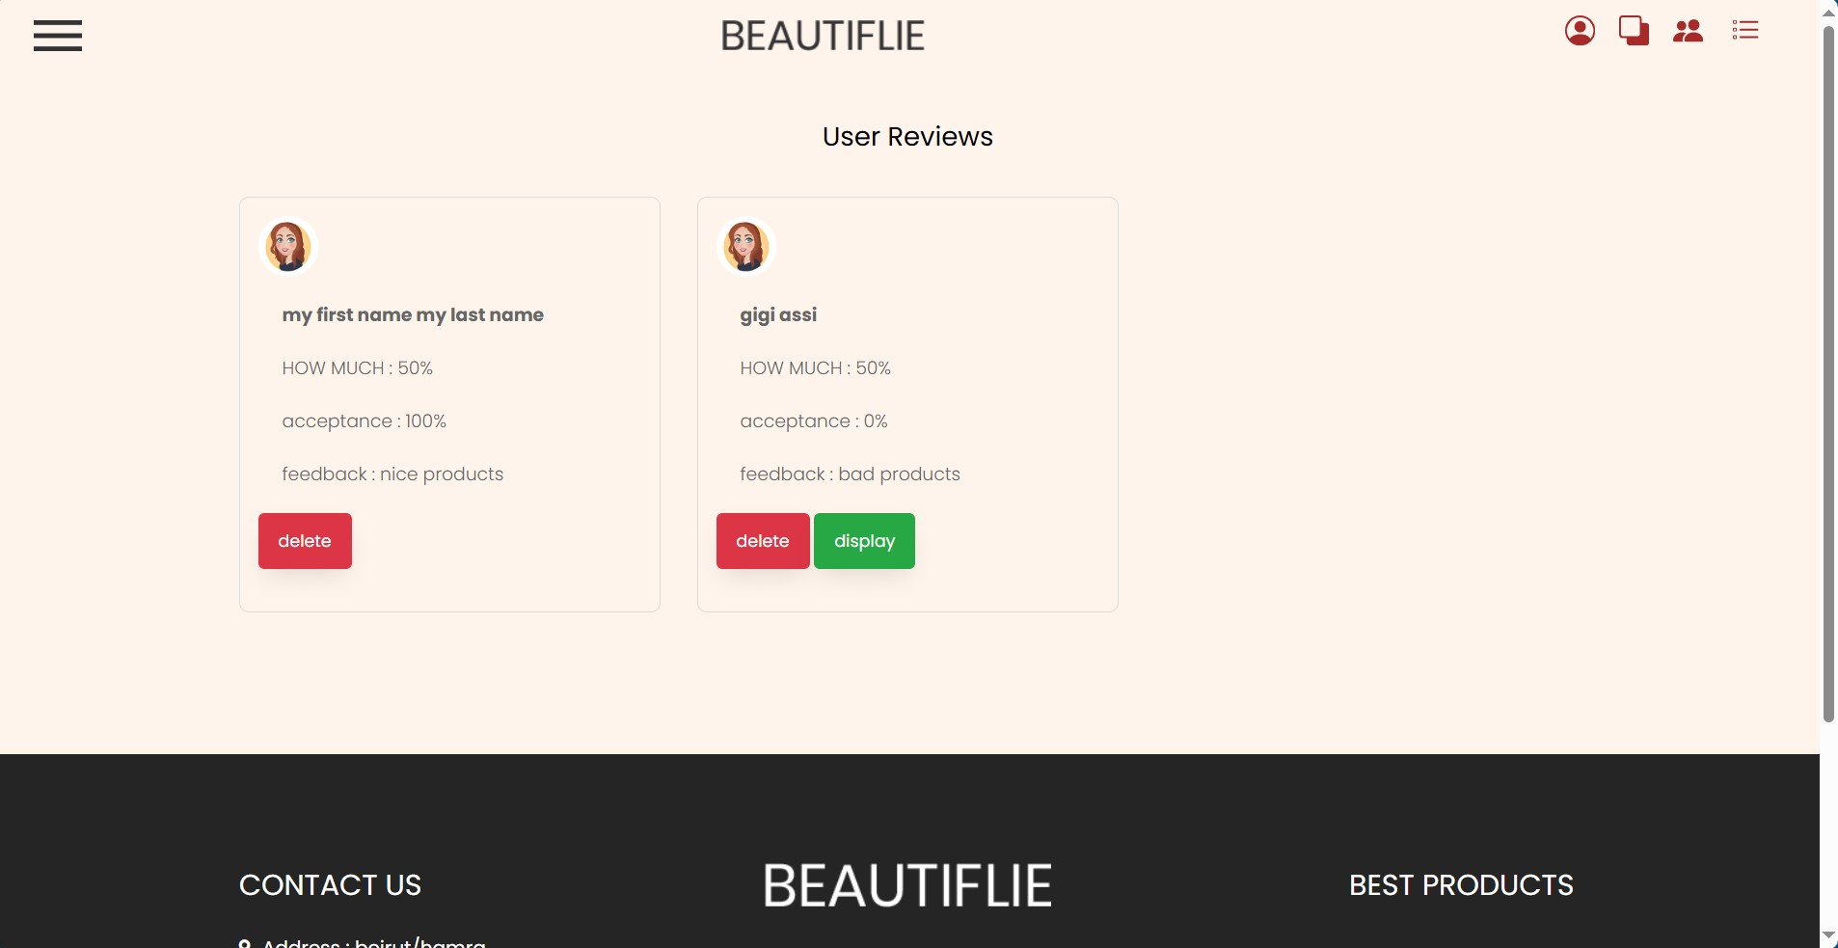

Slide 13
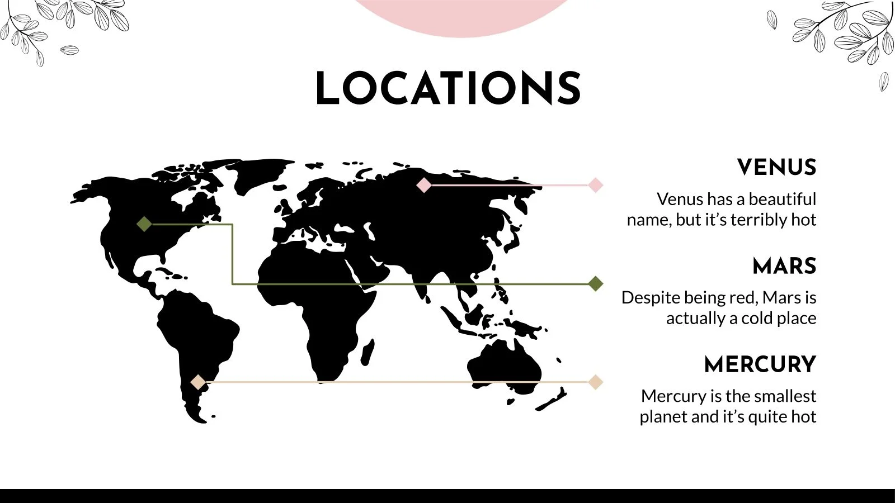
"We integrated functionality to add the location of our place on the website."

Slide 14
4
Future features

Slide 15

Improved Search Options: Find products quickly with better search filters.
Language Options: Shop in your preferred language for convenience.
"An AI model that analyzes the ordered items of each user in order to suggest related products to them.“
Advanced Filtering Options: Allow users to filter products by various criteria such as price range, brand, ratings, and more.

Slide 16

Special thanks to Dr. Walid Fahes

